Slide 1
IPR Term 1 Week 7
Lab report writing (1)
Formative lab report
Dr Hayley Dewe
(Assistant Professor)

Slide 2
Announcements
Formative Assessment
Due 3rd December 2025
UPDATED information now on ultra (template, marking rubric
AI declaration form – you must complete first (once you’ve written your report), to see the submission folder
See the Assessment Brief for level of AI permitted
Remember department policy: you’re not permitted to upload any of our slides/exam questions/data into AI!

Slide 3
Learning Outcomes
Understand how to write a lab report and the key sections
This is part 1: aka what is necessary for your Formative lab report:
Title, Introduction, Methods, Results and in-text citations
Understand good examples / practices in report writing

Slide 4
Lesson Outline
IPR Formative info, disclaimer
Writing a Title
Writing an Introduction
Writing the Methods
Writing the Results
In-text citations
General advice / tips and FAQs
Online hour content

Slide 5

Formative lab report

Slide 6
Disclaimer
Most advice today is relevant for both the course and real (published) papers / reports
Lab report writing for IPR (or in Year 2) may slightly differ to writing a ‘real world’ paper e.g.,
Lacking justification / novel research
Limited demographic info (testing on each other)
Limited choice in experiments (practical reasons)
Reports here may slightly differ for Year 3 dissertations e.g.,
Supervisor requirements / preferences on style and what to include
More choice of experiments here (but still some limitations, dependent on supervisor etc.)

Slide 7
Formative Lab Report
Requirements
Read “What you need to do” document for important info!
Due: 3rd December 2025 (just under 2 weeks time!)
Words: 1500 max
Include:
Introduction (short / mini review of RHI)
Method (RHI)
Results (Data from the practicals, descriptives only)
Template: on Ultra
References: not required, but in-text citations are required

Slide 8
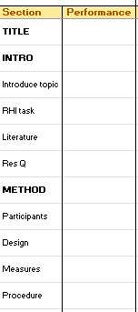
Formative Lab Report
Marking
Formative: you will not receive a grade. It doesn’t count towards the module
Marking rubric (criteria)
When your submission is given back to you, you will see:
Grade will be 1 (been marked/it’s passed) or 0 (not been marked or not passed due to missing too much information)
Text comment summary box: column indicating performance against each criteria
Performance ratings: P (Poor), S (Satisfactory), A (Average), G (Good) or E (Excellent)

Slide 9
2. Writing a title

Slide 10
Writing a Title
The goal of a Title:
Communicate the main topic and scope clearly: readers should immediate understand what your study is about
Reflect the key variables or relationships: often the main variables or key topic / phenomena
Be concise yet informative: should summarise the research without being too long or vague
Helps discoverability: help others find your work in databases/search. Make it interesting and engaging – you want people to find and read it
First thing people read!
Very important!
Think about how you select papers – what kind of titles have piqued your interest or put you off.

Slide 11
Writing a Title
Best Practice Tips:
Include essential and relevant elements
e.g., key variables, phenomena, population, method or design where relevant
Avoid unnecessary / irrelevant words
e.g., fillers like “a study of”, “an experimental investigation into”
Keep it clear, concise and focused
Avoid vague or broad info
Avoid overly technical jargon (avoid acronyms & abbreviations)
There’s no word limit – but approx. 8-12 words
Avoid bias or sensationalism
Can explain results (if you had one), but the tone should still be descriptive / neutral rather than persuasive or dramatic
Titles in the ‘Real world’:
Check journal guidelines (e.g. some have word limits)
Use keywords strategically (Search Engine Optimization – visibility/traffic)

Slide 12
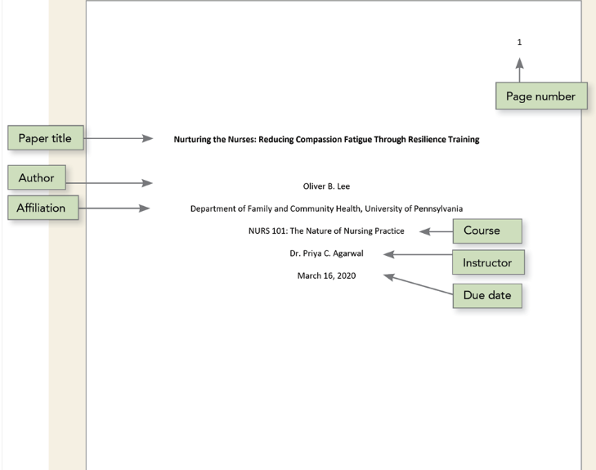
Title Page (APA style)
Title
centered, bold. No quote marks and in Sentence case
Page numbers (throughout)
Author
Affiliation
Course, Module
Instructor
Due date
Author: DON’T put your name. Use Z-code
Below due date, we also ask for:
“Word count: XX”

Slide 13
Example Titles
Instead of: A study on mental health in students
Consider: examining the impact of social media use on anxiety and sleep quality among university students
Instead of: stress in high school students
Consider: investigating how academic pressure affects stress levels among high school students: A qualitative interview study
Instead of: the impact of parents on development
Consider: parental involvement in language development of preschool-aged children
Instead of: investigating the impact of sleep deprivation
Consider: assessing how sleep deprivation affects memory retention in undergraduate psychology students

Slide 14
Example Titles
Which is more effective?
Why and When Hierarchy Impacts Team Effectiveness: A Meta-Analytic Integration
Hierarchy and Team Effectiveness
A Study of the Effect of Depression on the Decision to Join a Clinical Trial
Effect of Depression on the Decision to Join a Clinical Trial
Closing Your Eyes to Follow Your Heart
Closing Your Eyes to Follow Your Heart: Avoiding Information to Protect a Strong Intuitive Preference

Slide 15
3. Writing an Introduction

Slide 16
Writing an Introduction
The goal of an Introduction:
Set the context: explain the broader topic (what has been done before) and why it matters. Give readers the background information
Review relevant literature: summarise key studies (previous literature) and theories. Your evidence to support your study – so pick relevant/related research.
Identify research gap/problem: what’s missing in current research, understudied or unclear? Justify the need for your study based on ‘gaps’.
State aims and hypotheses: end by outlining what your study will test or explore. State predictions on findings where possible – based on prior evidence. Predictions shouldn’t come out of nowhere! It should ‘make sense’ because of the evidence described above.

Slide 17
Writing an Introduction
Context and Background: general information on the topic.
Problem Statement: define the issue your research will address.
Rationale: Explain why your study is necessary/interesting
Research Question(s): Specify what you aim to achieve
The Funnel Method
Begin general. Briefly introduce topic or general issues. e.g. how does your study/research area relate or apply to the real-world?
Review relevant literature, theoretical / experimental background and relate these to your study.
Provide justification / rationale for the study based on review.
IPR formative: just 1 and 4. You can do a little bit of 3 – why is it interesting to study
Aims &
RQ

Slide 18
Writing an Introduction
Best Practice Tips:
Takes practice!
Set stage for your study – be selective about previous literature (can’t cover it all)
Think about the reader: assume they don’t know the topic. What are the main findings they should know?
Form a narrative: ‘lead’ the reader to your study
Lead the reader to the research gap (Formative = no, Summative = possible)
Include some theory (more advanced): theoretical interpretations / importance of the research
State clear research question. End the introduction with a clear outline of what you are researching.
State clear a prediction about what you expect to find (i.e. hypothesis). You can be specific e.g., X higher than Y. Or if (from the literature you presented) it’s still unclear, say an expected difference between X and Y

Slide 19
Discussing Previous Literature
Think about:
Write as if the reader hasn’t read the studies
Write in *enough* detail (e.g., aim/purpose, method, results, conclusion) so we understand what they did.
Why have you included it? What point are you trying to make?
Is it the most relevant to your current study? Why?
How does it compare to your study?
IPR Formative: mini-intro. Give the reader a good (but brief) background/context of RHI work so far. The general findings/trends.

Slide 20

Discussing Previous Literature
Some “Do’s” when describing a study:
Do provide context – introduce or link to the study (so the reader knows why you have included it). Why it is relevant?
Do briefly mention the method: enough context so we understand their study / how it differs to yours. Summarise what’s relevant – avoid listing every measure or step.
Do briefly describe key findings: we don’t often need to know every result. Just main / important one’s that relates to your RQ.
Do briefly describe their conclusion: take home / major conclusion that’s most relevant.
Do evaluate – limitations or what the study addresses/extends. How the study/findings compare to your own study (e.g., did they use a different sample, was their method stronger or weaker?)
Do cite the research. In-text citations must be included as evidence/support for arguments/points (APA style).

Slide 21

Discussing Previous Literature
Some “Dont’s” when describing a study:
Don’t give excessive detail: we don’t need every detail of the method or findings of study etc. This is hard to do! Also, studies may require more detail than others.
For example, what information do we need from this sentence?:
"The study involved distributing a 35-question survey to 1,200 participants, with questions ranging from demographic details to anxiety and stressors.“

Slide 22
Discussing Previous Literature
Some “Dont’s” when describing a study:
Don’t give excessive detail: we don’t need every detail of the method or findings of study etc. This is hard to do! Also, studies may require more detail than others.
For example, what information do we need from this sentence?:
"The study involved distributing a 35-question survey to 1,200 participants, with questions ranging from demographic details to anxiety and stressors.“
Here the most important part is that participants provided ratings for anxiety and stressors.
If you’re comparing studies/method directly or using it to justify a method – then that it was a survey is also sometimes important.
Re. the sample size (1200 participants) – not typically included. But it could be, if you’re making a specific point about it (e.g., a large sample size being a good thing) or making a point about it (to compare/contextualise to your own study).
BUT: “I ran their same study with a larger sample size” is NOT justification of a study!

Slide 23
Discussing Previous Literature
Some “Dont’s” when describing a study:
Don’t give excessive detail: we don’t need every detail of the method or findings of study etc. This can be challenging! Also, studies may require more detail than others.
Don’t copy the study’s words/language and don’t use quotes. Quotes should be avoided. Write about the study in your own words
Don’t overemphasize what the study measures/shows (to suit your own narrative) or ‘cherry pick’ - focus on the elements of the study that relate to your RQ but it must be balanced/representative
Don’t critique without purpose: if you point out a limitation of a study – it must be for a reason/relevant (you seek to address it / identify a gap)
Don’t list studies without explanation/links. Integrate them into a coherent narrative that connects to your RQ. This is challenging! Advanced: collate studies/citations

Slide 24
Critiquing a study
Less relevant for IPR lab reports
Typically…
In the Introduction and Discussion.
And you only critique a study if you plan on fixing/improving that point in your own study! Even if you can’t improve it all, you tend to make a ‘step’ in the right direction.
It’s difficult to do and takes practice.
Limitations and critiques must be justified (e.g., evidenced) and convincing
Let’s look at an example - everyone’s ‘favourite’ “small sample size” (ft. Michael Scott)

Slide 25
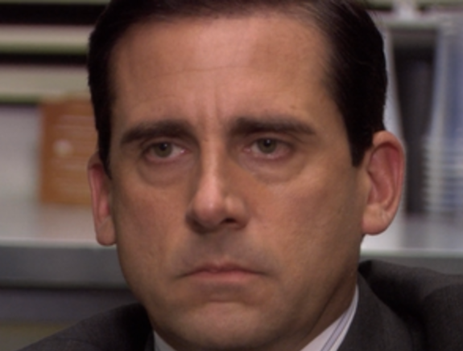

Critiquing a study
Student writes “A problem with this study is that it had a small sample size”
Vague, unconvincing. What is considered small/large? How does this affect the results/interpretation?
Sample size isn’t a convincing limitation (unless you have the statistics to back it up)
Student writes “The study’s small sample size of 30 participants may limit the generalisability of the findings to a broader population”
More detailed but still unconvincing. How do you know that with more than 30 people there would/wouldn’t be an effect?

Slide 26

Critiquing a study
Student writes critique with some statistical knowledge/evidence (or should search the study for it)
e.g., “The sample size may have limited statistical power, increasing the risk of Type II errors. As a result, the study might have failed to detect a smaller but meaningful effect. Without a power analysis or confidence intervals, it is difficult to judge whether the findings are robust”
Stronger! More specific – explains why sample size matters, suggests what could be missing (power analysis).
If a study had provided this statistical information and justified their sample – the argument is again unconvincing
So: critiquing sample size isn’t typically done. Sample size alone rarely determines validity.
Better critiques often focus on the design, measures or interpretation of findings

Slide 27

Critiquing a study
Instead, remember (and think about):
How useful is this to your overall narrative / review in the introduction?
How does it compare to all of the other studies you’ve mentioned?
Instead of harshly critiquing one study, or each study individually, you need to create an overall picture / story
Create an overall narrative of general patterns or trends
Compare and contrast studies – what are they collectively suggesting?
The general findings/trends common issues (e.g. in methodology), or things that might have been missed, not controlled for or not explored?
Can’t base your conclusions on one study (nor be solely affected by their limitations)
What should readers believe / take away? General findings / ‘consensus’ of the topic

Slide 28
3. Writing a MEthod

Slide 29
Writing a Method
The goal of a Method:
Allow replication: provide enough detail so another researcher could repeat your study
Describe participants: who took part? Include sample size, demographics, recruitment
Specify design and variables – for example what design you are using, is it between-subjects or within-subjects, the independent and dependent variables (sometimes the type of analysis you used goes here too)
Explain measures and materials: what measures (or stimuli, materials) did you use? What questionnaires etc? How were they administered etc.
Describe the procedure: a step-by-step description of what the participants did

Slide 30
Writing a Method
Best Practice Tips:
Include sufficient details so that someone could copy and replicate your study exactly how you did it
Use sub-headings, in this order:
Participants
How many participants? Where are they from?
How were they recruited? Were they compensated for taking part?
Demographic info that is relevant to study, contextualise the findings (e.g., age).
Presented in a table or text (table often easier)
Exclusion/inclusion criteria
Will you have different groups? Then you can split the above information up per group – if useful for interpretation
You should also mention ethics here – just if it had some or minimal risk, and you had approval etc.

Slide 31
Writing a Method
Best Practice Tips:
Include sufficient details so that someone could copy and replicate your study exactly how you did it
Use sub-headings, in this order:
Participants
Design
State research design (e.g. experimental, correlation, qualitative)
Any advantages of the design for your research question?
Is it between-subjects vs. within-subjects
What are your independent variables (IVs) and dependent variables (DVs), how are they scored/measured or what type of data are they
Any other relevant details e.g., if you needed to group participants, counterbalanced the order of measures, randomised trials, controlling for extraneous variables (only state this if you did it)

Slide 32
Writing a Method
Best Practice Tips:
Include sufficient details so that someone could copy and replicate your study exactly how you did it
Use sub-headings, in this order:
Participants
Design
Measures (or materials / tasks / paradigms)
How will you collect data (e.g., online surveys)
List the measures/equipment you used.
Often a separate sub-heading and paragraph for each measure (e.g., “The Rubber Hand Illusion task”)
Do not write this as a bullet point list
Assume the reader hasn’t heard about your measures – explain
Cite the authors of the tasks/measures! If you didn’t create it

Slide 33
Writing a Method
Best Practice Tips:
Include sufficient details so that someone could copy and replicate your study exactly how you did it
Use sub-headings, in this order:
Participants
Design
Measures
Procedure
Step-by-step explanation of relevant/useful information
You don’t need to mention things that are ‘standard practice’ but e.g., briefly state you obtained consent and got ethical approval (but not typically more detail than that)
Be organised, and chronological
Where did it take place? How long did it take? In a single session?
Will different groups do things in a different order?
How much were participants told? Were they debriefed?

Slide 34
4. Writing the Results

Slide 35
Writing the Results
The goal of a Results section:
Present findings clearly and objectively: show what the data reveal (without interpretation). Use precise language, avoid speculation
Organise you results logically: follow the order of your research question(s), group related findings, separate distinct measures. Remember to introduce each result, analysis or figure for the reader!
Discuss key patterns / trends: make it clear / easy for readers to see the main results.
IPR Formative requirements:
Descriptive data only
Figure
And a table (optional) of the same results in the Figure
Comment on results (a broad interpretation)

Slide 36
Writing the Results
Best Practice Tips:
Remind reader of RQ, variables – how were data processed (e.g. average?)
Use sub-headings: break down results by hypothesis, RQ or measures.
Report statistics correctly: include precise values and double-check numbers, variables, outputs etc. for accuracy
Keep it concise and simple: focus on analysis relevant to your RQ, don’t overcomplicate or analyse the data in multiple ways
Use visuals: figures or tables for clarity / conciseness. Must be clearly labelled and referred to. Typically: we don’t repeat info in text and visually (but for the IPR formative you can)
Follow APA formatting: ensure correct formatting
Be transparent: use appropriate descriptives and figures for your data. Give enough detail for someone to replicate e.g. tests used. Report all relevant results (including non-significant results), and all measures in your Methods
Be consistent: use same terms for measures throughout (or same formatting, style, units etc.)

Slide 37
5. in-text citations (references)

Slide 38
In-text citations (referencing)
Goal: Acknowledge sources that you have consulted and used
Citations: in the text (names and dates only, short-hand refs
References: listed in full, title of the paper, journal, date, page num. etc. not called a bibliography
(These should match!)
Evidence all claims / points (e.g. findings you’re discussing in the literature) (e.g. Introduction, Discussion)
Cite / acknowledge those who made the materials you’re using (e.g. Method)
APA style guide: In-text citations
IPR Formative = Citations

Slide 39
What can I cite?
You should only cite empirical research (primary sources, published journal articles)
While some of these may be useful for background reading/understanding:
Don’t cite:
Review articles – use sparingly/avoid
Wikipedia or other general ‘psychology’ websites
Textbooks
Blogs/posts/videos etc.
Secondary papers you’ve not read (e.g. if one paper cites another)
Do NOT use older versions of APA – use the APA 7th version. Otherwise, things like referencing / formatting will be outdated and incorrect (link in template document)

Slide 40
In-text citations (referencing)
Citations can go in parentheses
Surname(s) and date only, use “&” if it’s in brackets:
“Studies have found that statistics anxiety decreased after attending IPR lectures (Walker & Jones, 2020)”
or
Include as part of a sentence (out of parentheses) use “and” not “&”
“Walker and Jones (2020) showed that …”
One author: Smith, 2025
Two author: Walker & Jones, 2020
Three or more authors: Frost et al., 2013 - notice the punctuation!
Discussing a study in detail: you don’t need to write the citation after each sentence! So long as it’s mentioned once, nearby etc.

Slide 41
In-text citations (referencing)
Citing multiple research at once – i.e., multiple citations in parentheses
Order them alphabetically by first author’s surname
Separate citations with semicolons
e.g., Brown, 2019; Jones, 2018; Smith, 2020
If two or more papers have the exact same author(s) and year, add lowercase letters after the year
e.g.., Smith, 2020a; Smith, 2020b

Slide 42
6. General advice/tips and FAQs

Slide 43
General Advice
The goal of a lab report/paper/research article: to communicate your ideas effectively (and in the real world - so it could be replicated)
Keep it simple and clear
Avoid overly complicated language – an ‘easy-read’ for the reader
Write logically and sequentially – ensure each part flows naturally to the next. Transitions between ideas should be smooth
(e.g. don’t talk about findings before you’ve explained a method)
Writing style: past tense, active voice (increasingly preferred) e.g. we collected the data online or passive (the experiment was conducted online).
Use sub-headings? Where appropriate e.g.,
Method section = Yes
Results = Yes
Introduction = No or only if it adds something / helps clarity and used correctly (writing should flow/link as if they weren’t there!)
Since your formative introduction is mini: sub-headings are not needed

Slide 44
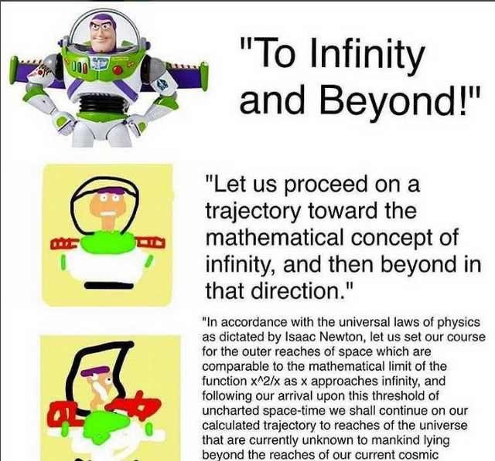
Writing Style
Write for your reader
Goal: understanding rather than overly convoluted
Use short, familiar words over long, formal ones
Use academic terms and technical terms but if you mention it, briefly define it
Avoid unnecessary jargon
Use SHORT sentences. Keep sentences short and active
Avoid long/too few paragraphs (one main idea per paragraph)
Read aloud / ask someone to read it (simplify it if it sounds unnatural or difficult)
Aim for clarity, not impressiveness

Slide 45
Complicated vs Clear language
Complicated
Clear & Concise
The Rubber Hand Illusion constitutes a paradigmatic exemplar of visuotactile integration anomalies within corporeal self-representation. | The Rubber Hand Illusion is a well-known example of how the brain integrates visual and tactile information to create a sense of body ownership.
The experimental manipulation engendered a perceptual recalibration of corporeal ownership, underscoring the malleability of embodied selfhood. | The procedure altered participants’ sense of hand ownership, highlighting the flexibility of body perception.
This phenomenon elucidates the susceptibility of multisensory integration processes to exogenous perturbations, thereby challenging the invariance of bodily selfhood. | The illusion demonstrates that multisensory integration can be influenced by external factors, questioning the stability of body ownership.
Empirical findings accentuate the salience of temporal congruency in visuotactile input as a determinant of illusory embodiment. | The results show that the sensory timing between visual and tactile signals is crucial for creating the illusion of ownership.

Slide 46

Think about the reader
Intended audience / readership is important
Assume readers have some basic background knowledge and interest in psychology
e.g., know what an ‘experiment’ is, “reaction time” or what ‘anxiety’ means (don’t define)
But assume they aren’t familiar with topic-specific knowledge.
e.g., don’t know the RHI, nuances of embodiment or of specific measures (define)
Or how a topic is quantified or explored in your specific study
e.g., how you’re measuring perception (define)

Slide 47
FAQS
How much detail is “enough” for a study?
There isn’t a wrong/right amount. You can’t cover it all, you need ‘enough’ to provide relevant context
How long should each section be e.g., Methods?
Depends on assessment, I provided approx. word counts for each section. Real-world: journals tend to have own limits
Should we cite the questionnaires we used for the RHI?
Yes. You they based on Botvinick & Cohen so cite them
How many studies / how much literature should I cite?
There isn’t a wrong/right amount!
There’s more on the FAQs document please read this and regularly read/check the discussion board

Slide 48

Online our Content
Nothing this week ☺
Prepare and continue with your formatives
Or
Time for catch up on previous weeks

